Slide 1
Annual Report 2020-2021

Slide 2
Promoting Health, Fun, and Fitness Through
Cross-Country Skiing
…………………………………………………..
Accomplished Via:
Social Engagement
Programming, Outreach & Events
Advocacy for XC Skiing
Trail Building & Maintenance
Who Are We?

Slide 3
2020 – 2021
Programs & Events
DXC Kids Ski
Banff Mountain Film Festival – Virtual
Duluth CXC Cup Opener
DXC Passport!
Virtual Birkie Partner
Tour Duluth Ski Festival
Programs & Events:

Slide 5
Generating a life-long love for cross-country skiing!
Thank You for making a safe KidSki in 2021!
Bobbie Larson
Kari Hedin
The Ski Hut

Slide 7
Banff Center
Mountain Film Festival
World Tour
2020/2021 Virtual Edition!
Films Available
November 2020 – October 2021
Proceeds Benefit DXC!
Visit: www.duluthxc.com

Slide 8
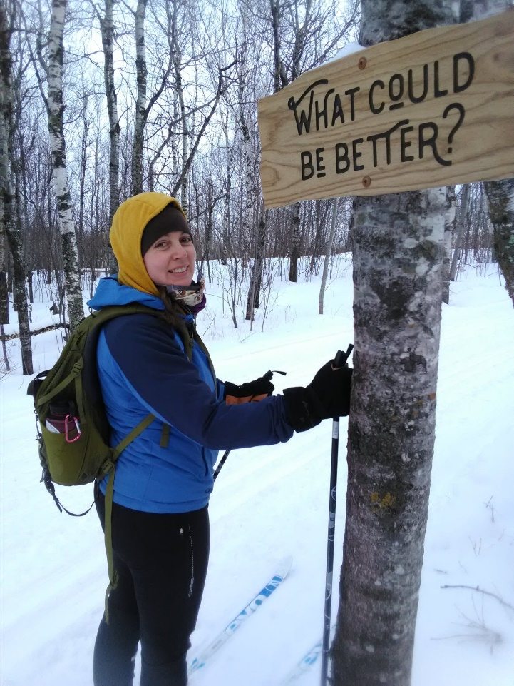
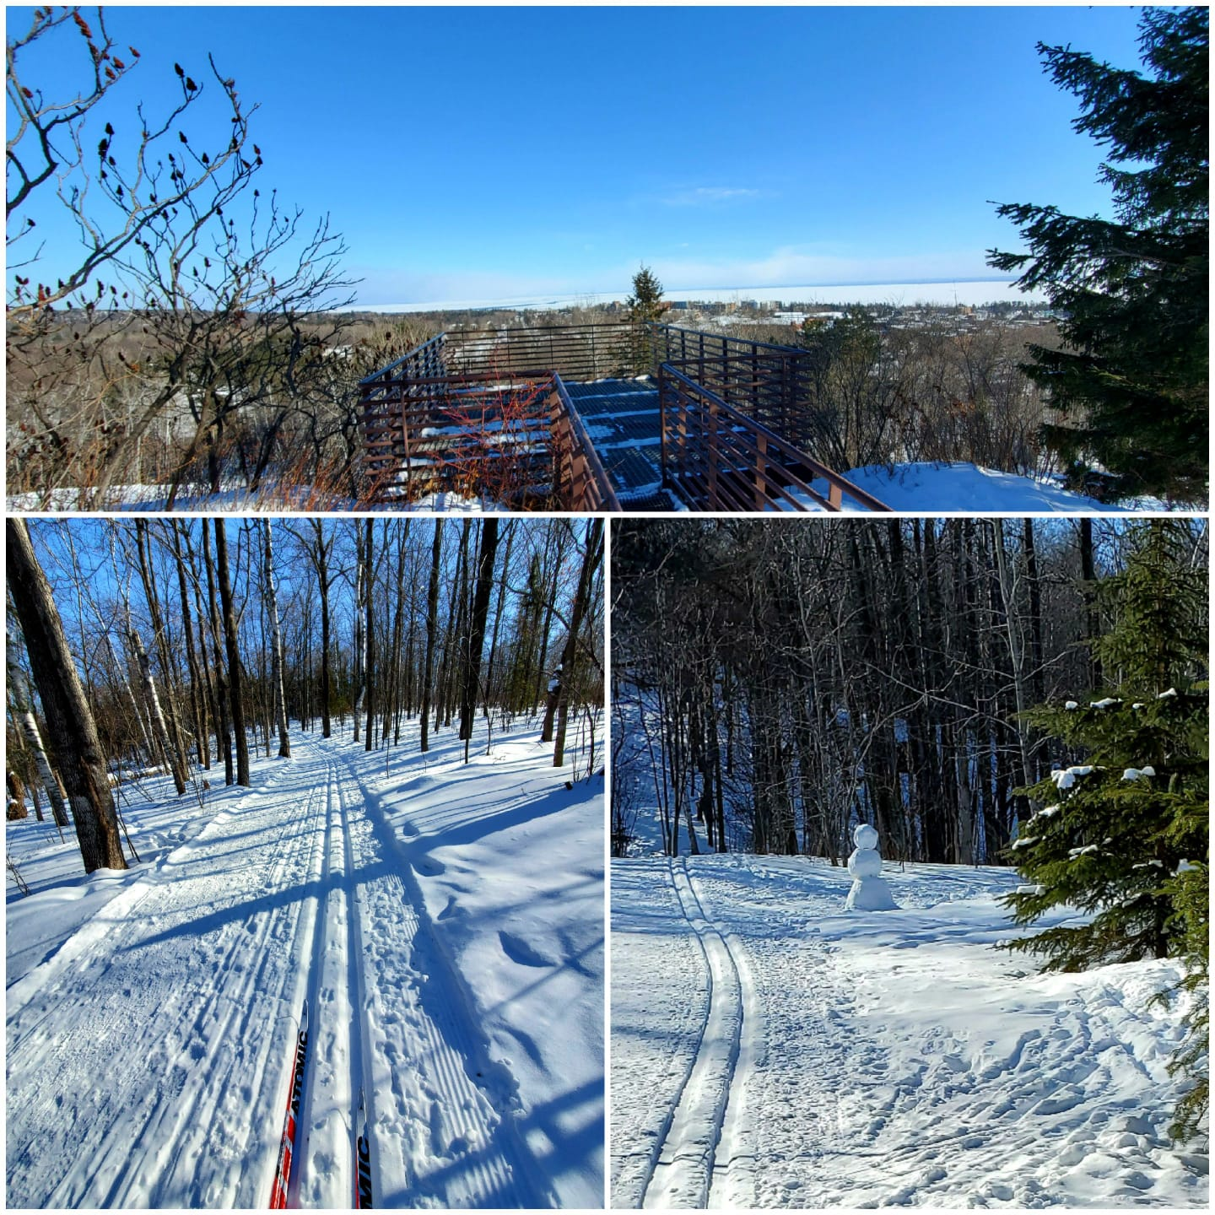
DXC Passport - Explore Our Great Trails!

Slide 9
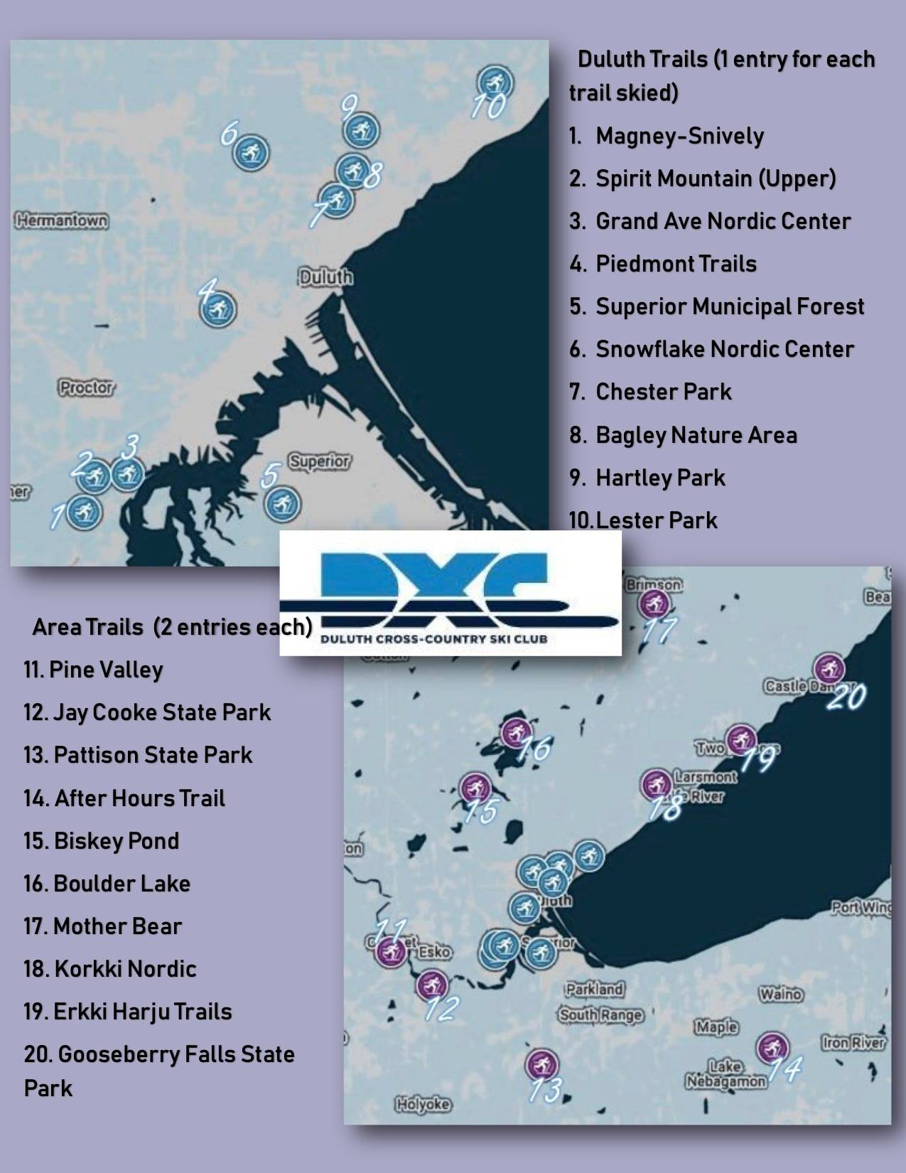

Slide 10
2021 Duluth CXC Cup!
290 Racers
from U16-U23

Slide 11
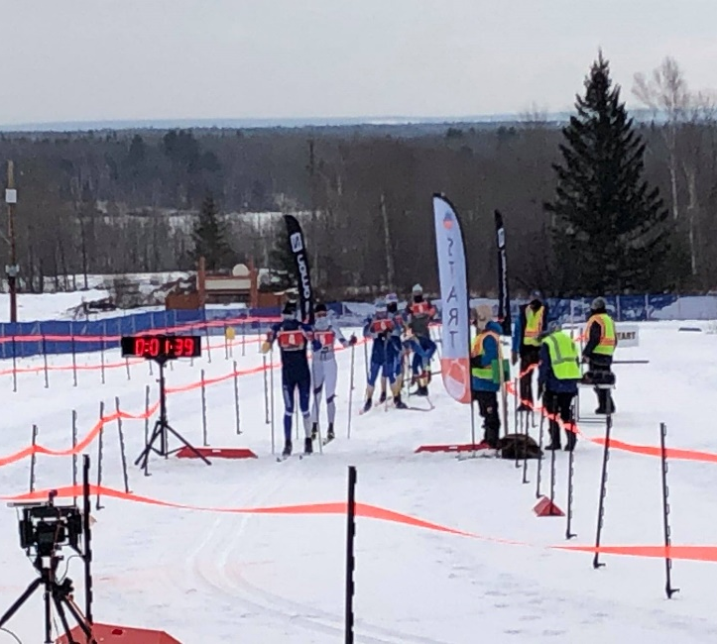
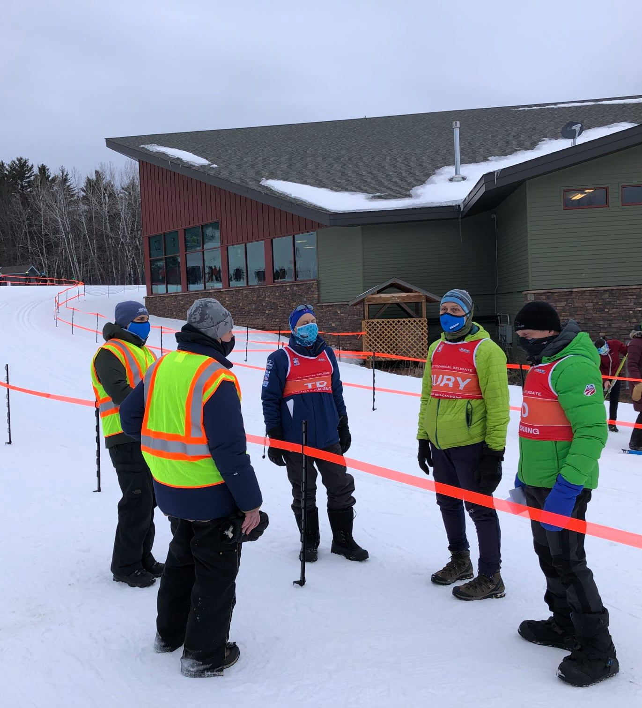
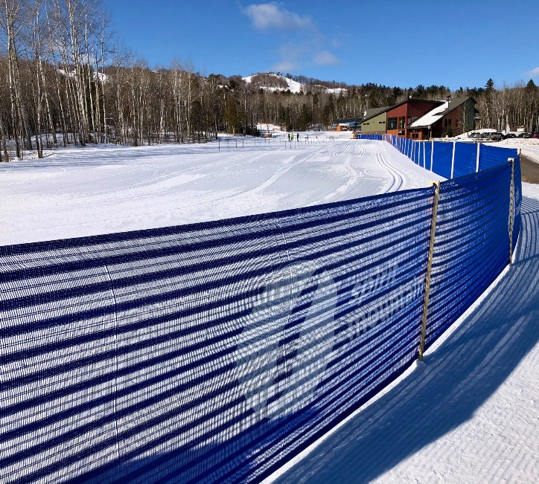

Slide 12
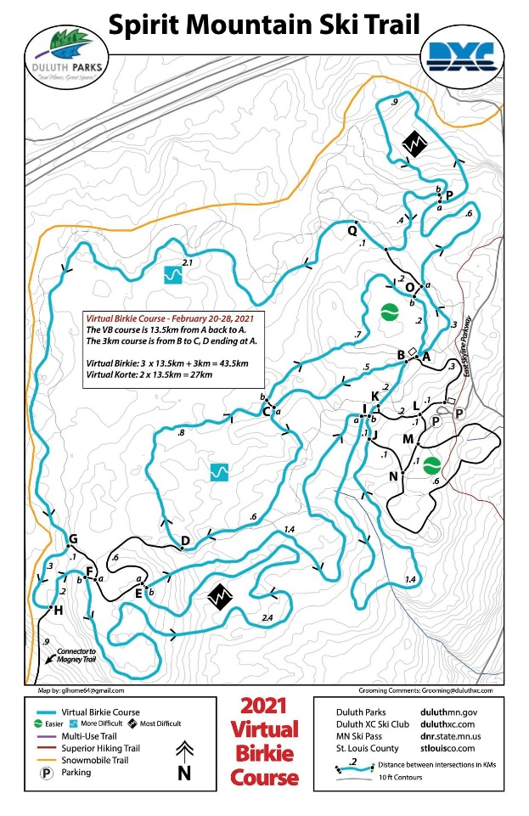
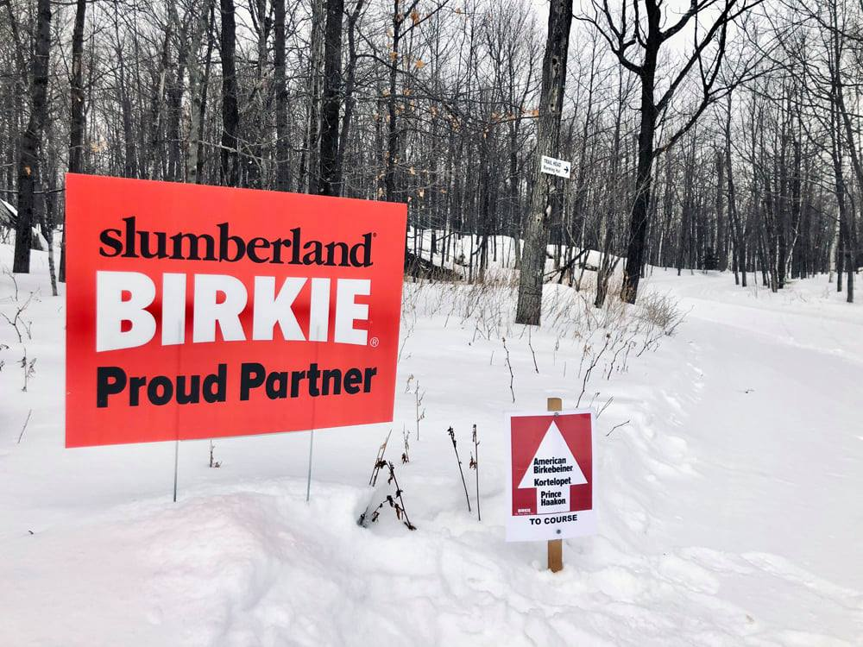
Virtual Birkie Partner!

Slide 13
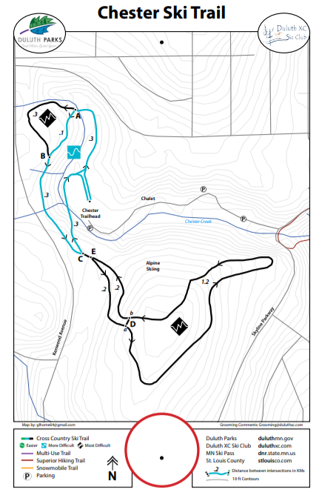
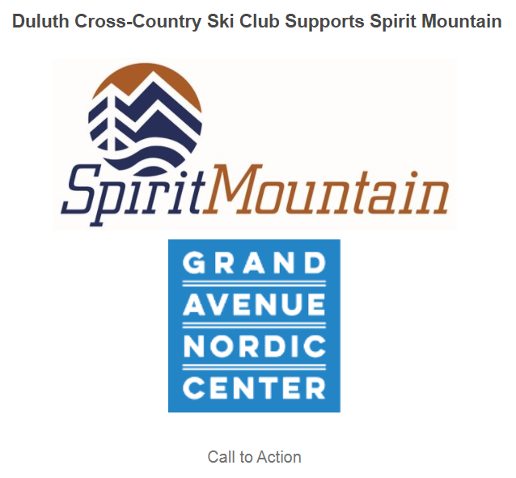
Advocacy for XC Skiing

Slide 14
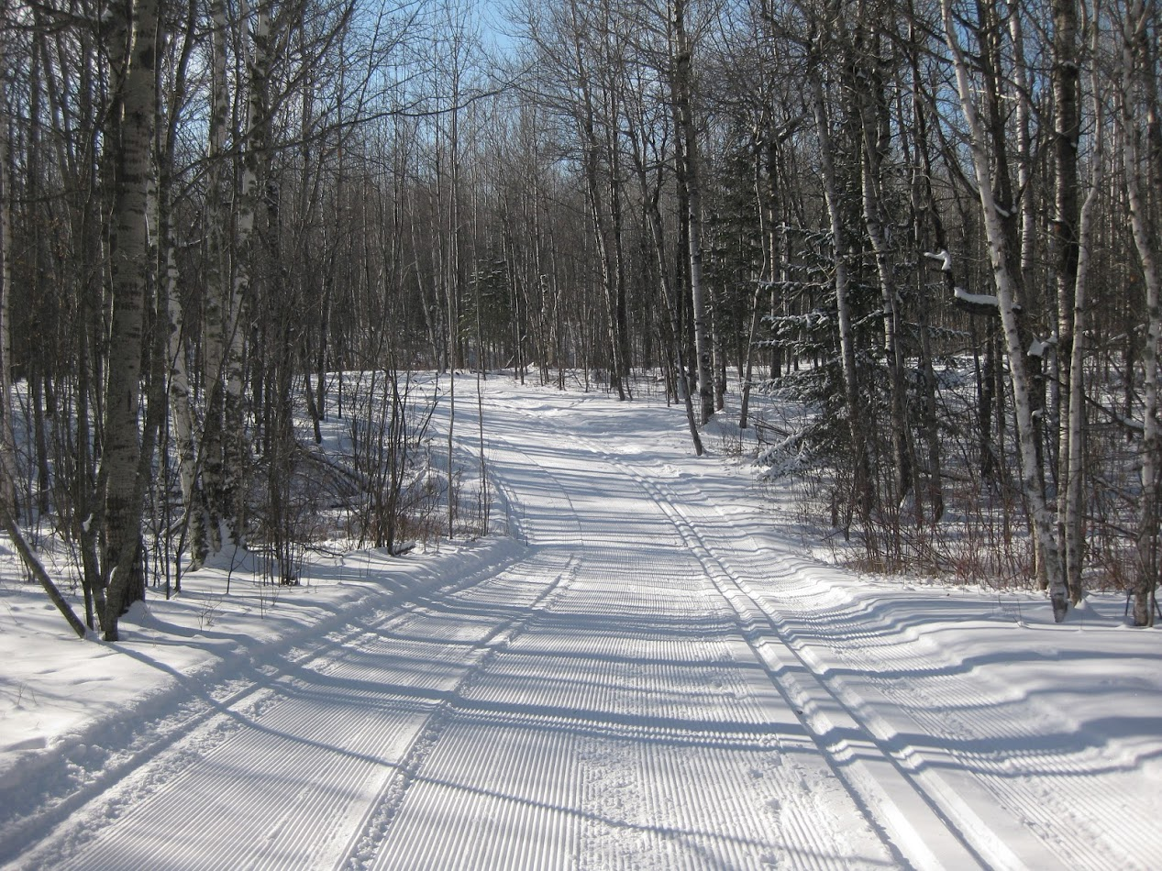
50 Miles of Ski Trails
Easy to Access
All Corners of Town
------------------------------
Trail Building
Trail Maintenance
Duluth Skiing, In A
Neighborhood Near You

Slide 15
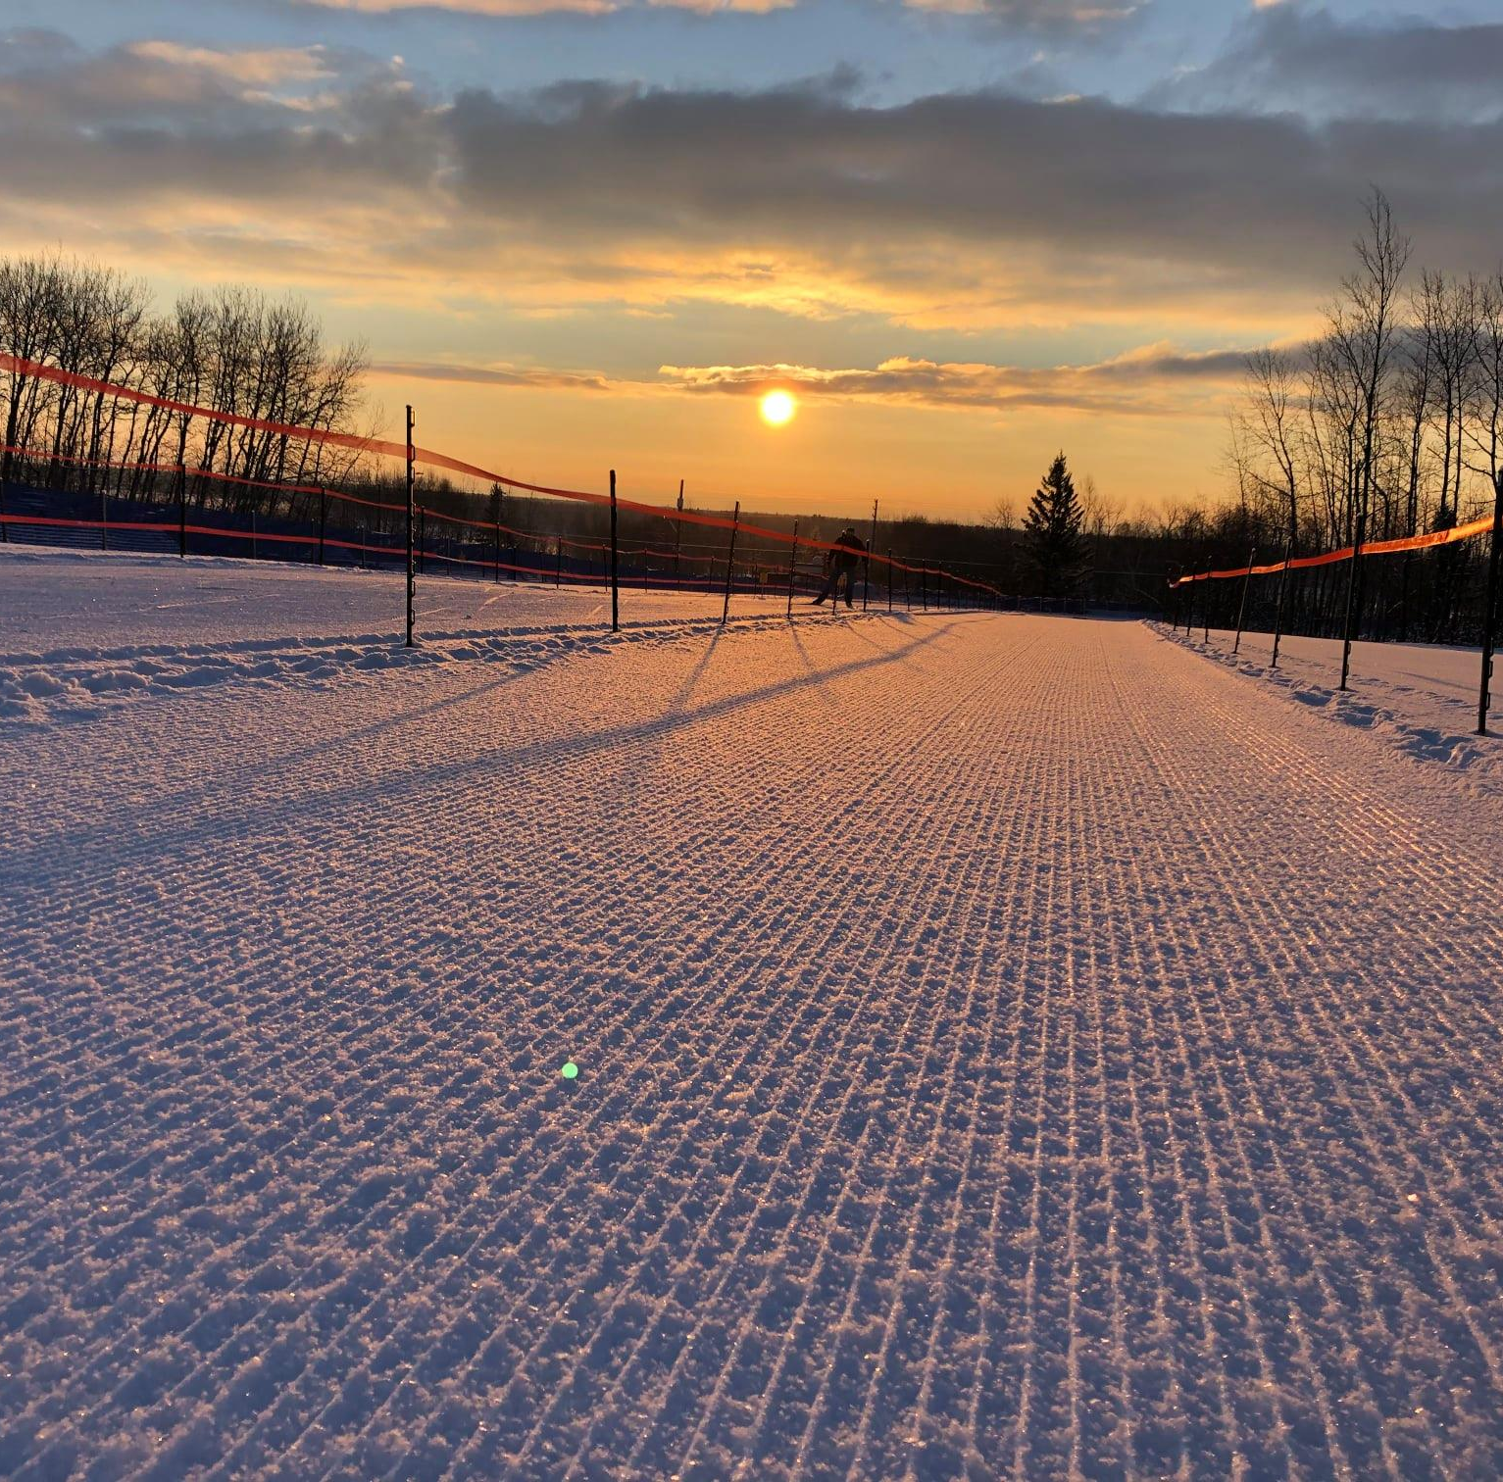
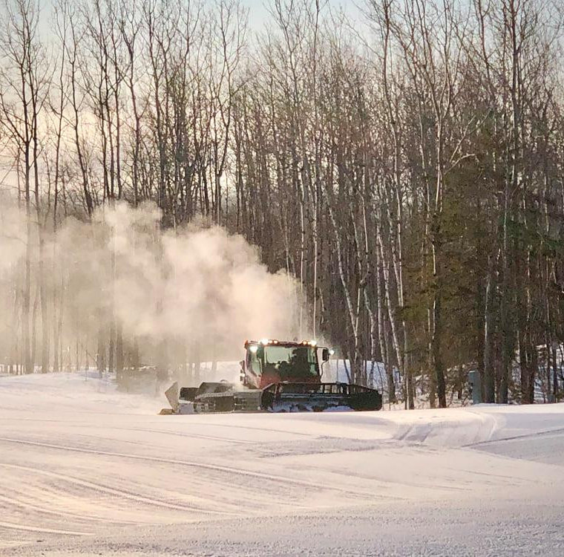
Grand Avenue Nordic Center (GANC)

Slide 16
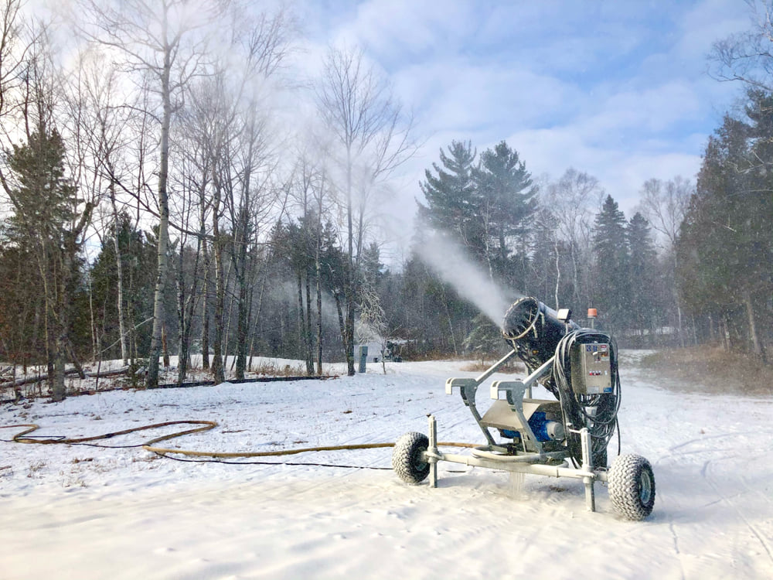
Total Funds Raised $865,000 !!

Slide 17
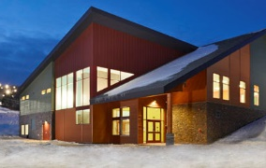
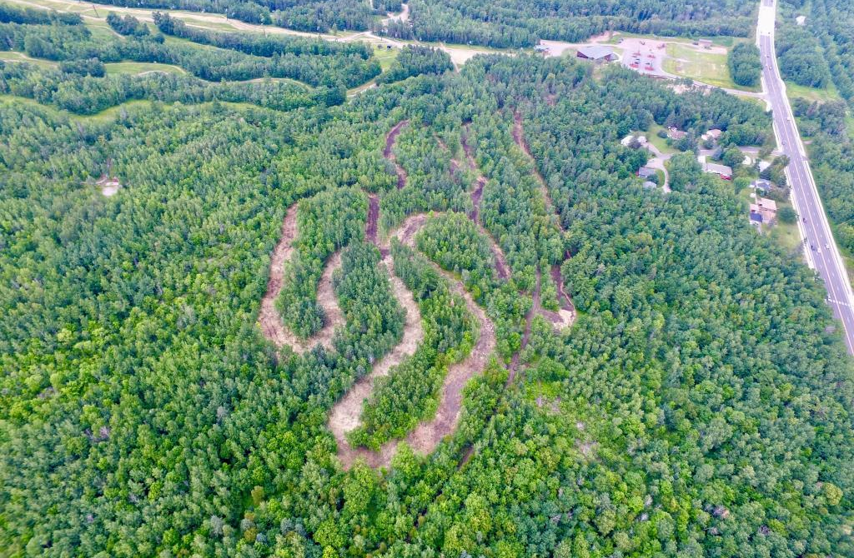
Grand Avenue Nordic Center Project Update:
DXC Capital Campaign:
Funds Raised $865,000
Additional Light Poles Available for Naming!
Legacy Grant:
Submit Application Spring 2021 w/ Determination Fall 2021
Remaining Buildout:
Lights Around Trails
Upper Trails
Fully Snowmaking Capability

Slide 18
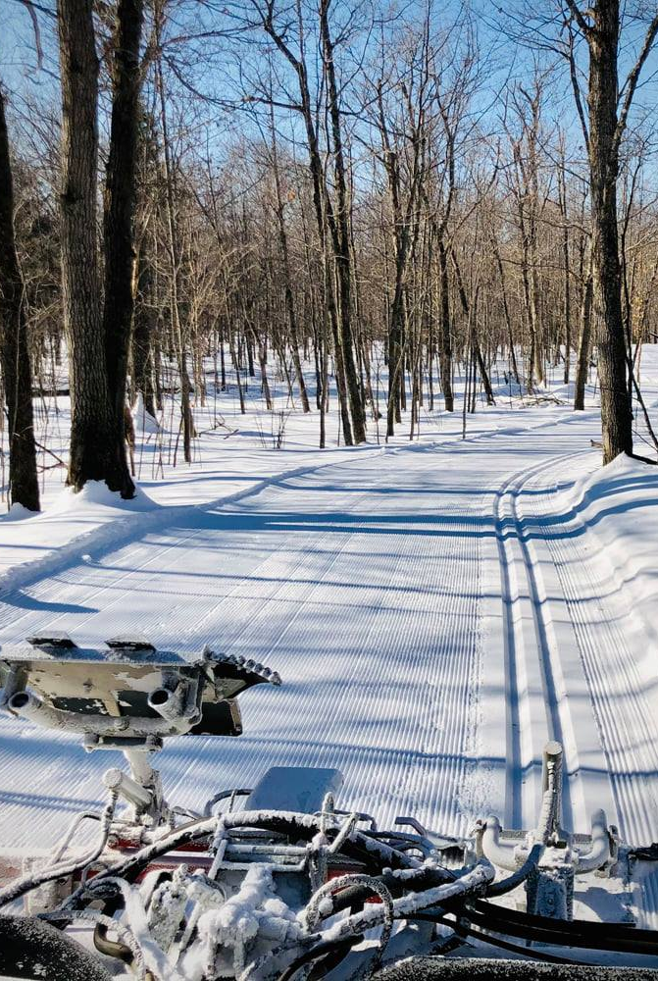
DXC Operates & Grooms:
Upper Spirit Mountain Nordic Trails
Thank You
Larry Mishkar!

Slide 19
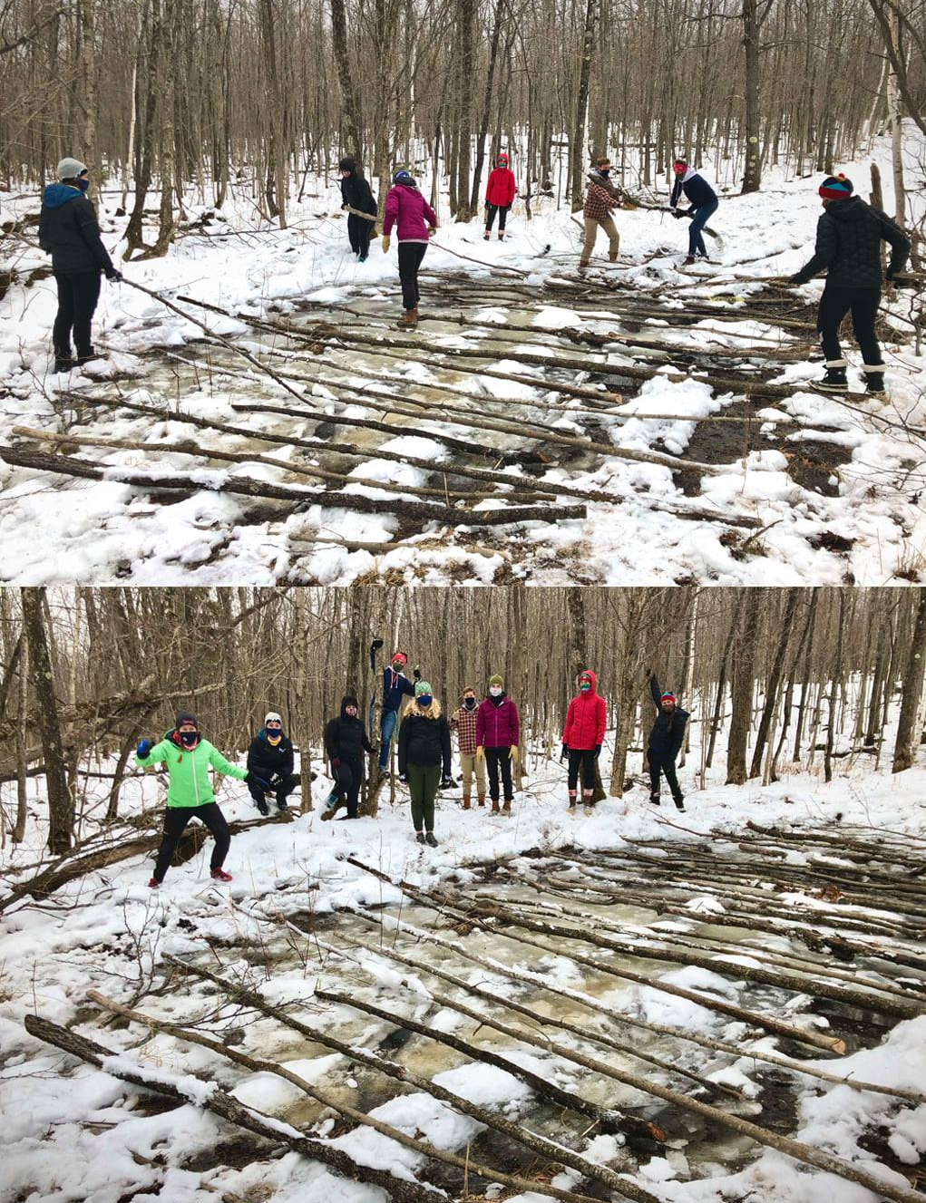
Thank You!
CSS Ski Team & Trail Volunteers

Slide 20
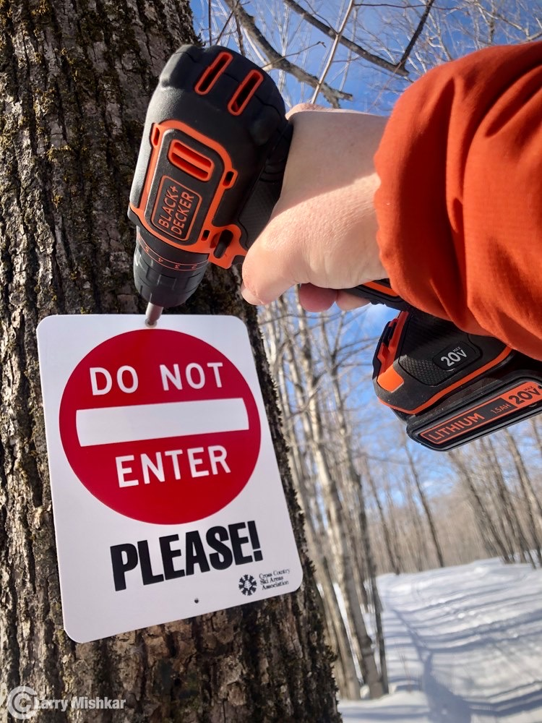
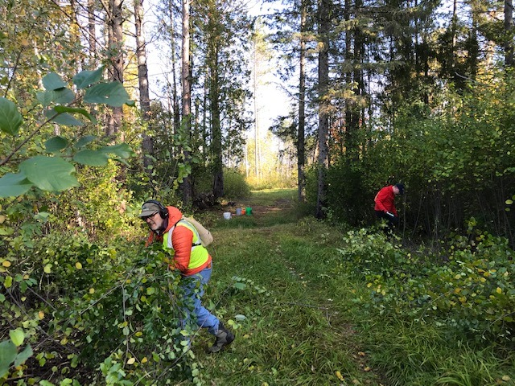
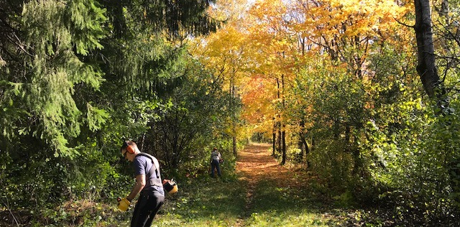

Slide 21
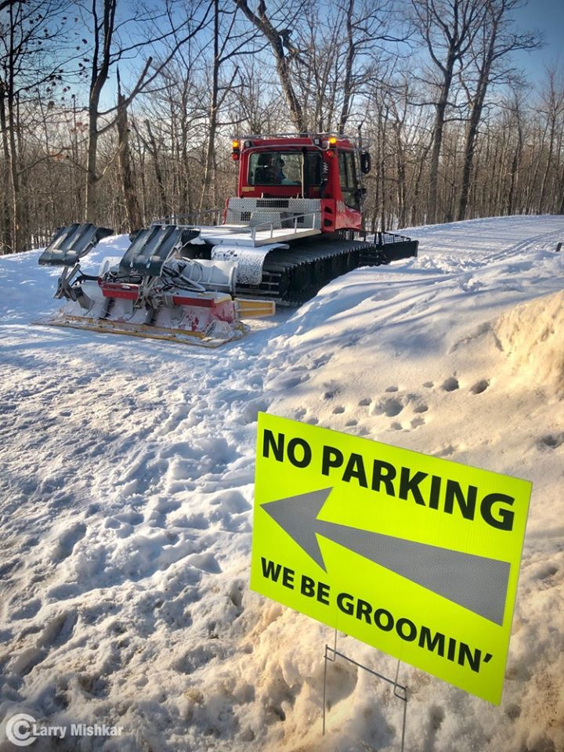
Thank You! – City of Duluth

Slide 22
2020-2021 DXC Board
Dan Maki - President
Jonathan Rova – President Elect
Sarah Grenberg - Secretary
Nick Lansing - Treasurer
Eric Chandler
Erik Julsrud
Jake Morgan
Waylon Munch
Mark Wallis

Slide 23
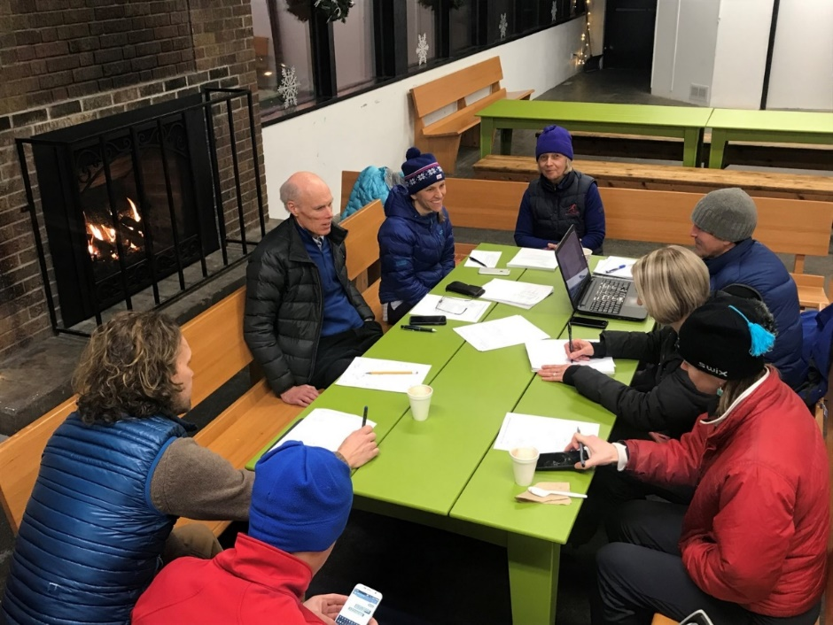
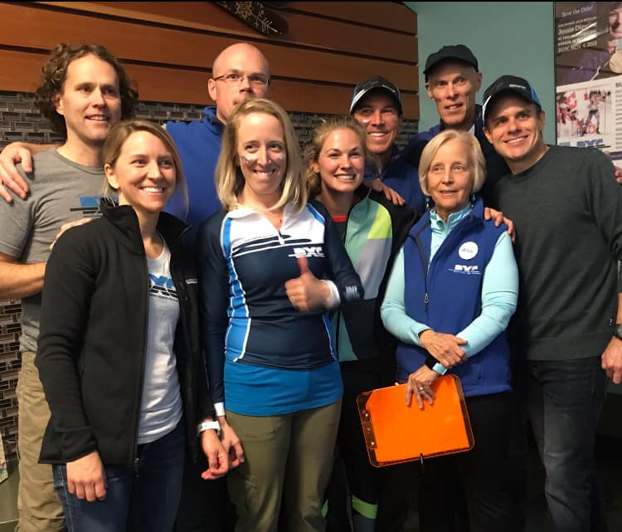
Get Involved in DXC!
Join the Board!
Make an Impact, Implement Change:
Applications:
www.duluthxc.com/get_involved
Join a Committee!
Membership & Volunteers
Communications & Publicity
Programming
Lester-Amity Chalet
Grants & Donations
Events
Trails
Races

Slide 24
Financial Update
As of (Feb. 25th, 2021):
Savings Account = $215,023
Secured for GANC project
Capital Commitment is $865,000 of which $650,000 has been paid
Checking Account = $17,234
Operations Account
Primary Operating Costs:
Programming
Lester-Amity Chalet
Grooming Upper Spirit Mtn. Nordic Trails
Events
Financials

Slide 25
Looking Forward:
Programming:
Review Opportunities for Kids & Youth Development
Grand Ave Nordic Center:
Finalize Funding & Buildout
Suggestions & Ideas Wanted!
We want to hear from you!
Submit Comments to:
info@duluthxc.com
Looking Ahead

Slide 26
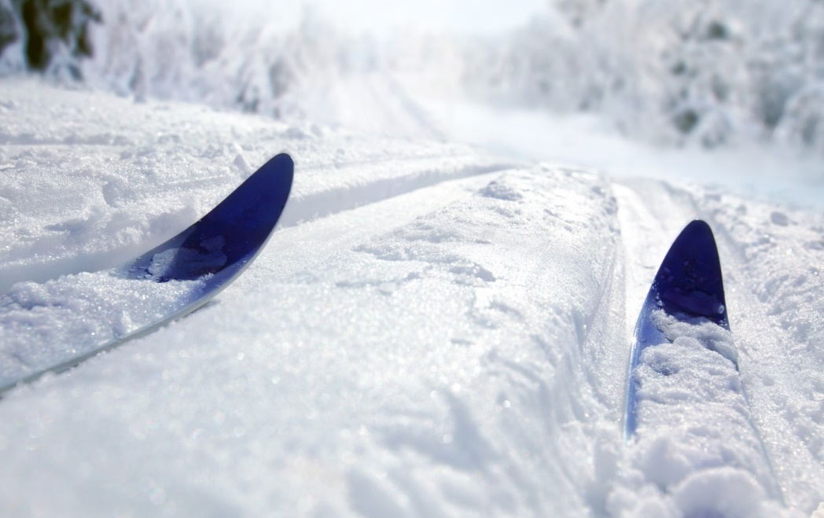
See You on
the Trails!

